Slide 1
Zrównoważony rozwój miast
Projekt Eco-miasto
Maria Andrzejewska
UNEP/GRID-Warszawa

Slide 2
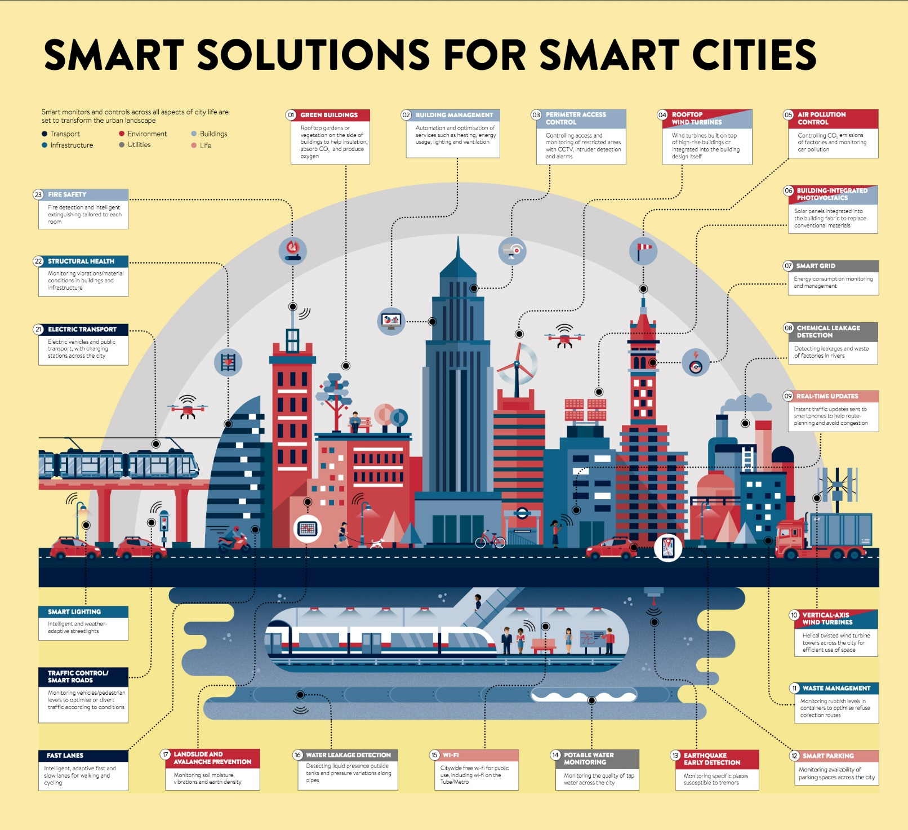

Slide 3
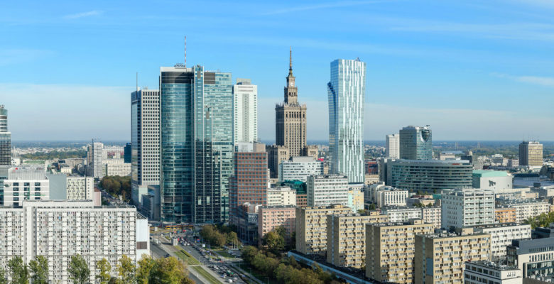
THE ROLE OF CITIES IN SUSTAINABLE DEVELOPMENT
Over the next 30 years, an additional 2.4 billion people are likely to be added to the global urban population resulting in a significant expansion of existing cities and the construction of new cities. Cities consume over two-thirds of the world’s energy and account for more than 70% of global CO2 emissions which shows the necessity to work towards the creation of sustainable cities.
Key issues for health, the environment and the economy in Poland:
Air pollution
Water pollution
Transportation
Building insulation & Heating
Waste disposal
Flood prevention
Warsaw City Center

Slide 5
THE ECO-MIASTO CONTEST
Launched in 2013, ECO-MIASTO rewards the best environmental initiatives of Polish cities. The contest seeks to encourage communities to develop sustainable city models and is divided into the following categories :
Sustainable Mobility
Water Management
Energy Efficiency in Buildings
Circular Economy
Green Spaces and Air Quality

Slide 6
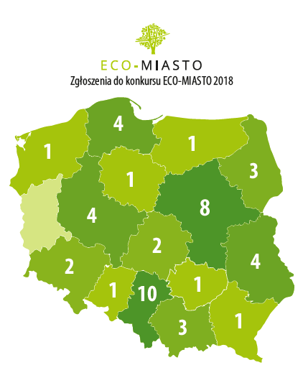
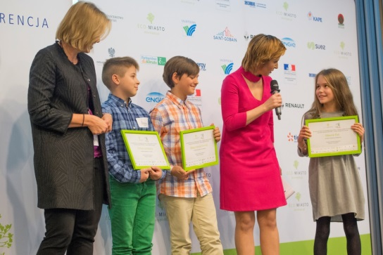
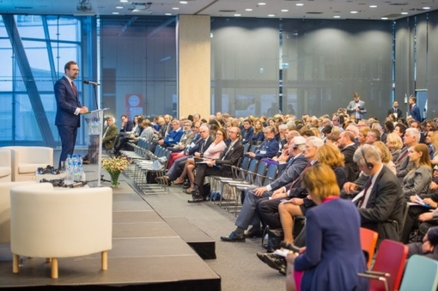
THE ECO-MIASTO PROJECT
ECO-MIASTO CONTEST
INTERNATIONAL CONFERENCE
EDUCATIONAL PROJECT
THE ECO-MIASTO PROJECT IN 2018
Educational project for the Youth with 52 educational establishments participating
An International conference held in Warsaw and attended by more than 600 participants from 11 countries
46 participating cities

Slide 7
„Eco-miasto” competition, awarded cities 2017
Sustainable Mobility
Water management
Waste management
GDYNIA >100 k
JAWORZNO <100 k
Secondary awards:
Poznań,
Żory
CZĘSTOCHOWA >100 k
LESZNO <100 k
Secondary awards:
Wrocław,
Jastrżebie Zdrój,
Ostrów Wlkp
GDYNIA >100 k
WOŁOMIN <100 k
Secondary awards:
Warszawa,
Stalowa Wola,
Płońsk
Energy efficiency
Energy systems
Air and greenery
GDYNIA >100 k
KARLINO <100 k
Secondary awards:
Kraków,
Kalety,
Mińsk Mazowiecki
KATOWICE >100 k
OSTRÓW WLKP. <100 k
Secondary awards:
Lublin,
Słupsk
LUBLIN >100 k
KARTUZY <100 k
Secondary awards:
Wrocław,
Warszawa,
Słupsk

Slide 8
International Conference Innovative Eco-City 2018:
Event report
Download: https://www.gridw.pl/innowacyjneecomiasto18/materials?lang=en

Slide 9
ECOCITY development - use of information and communication technologies (ICT)
Digital TWIN – concept supporting management based on spatial approach
to ‚monitor and optimize’ resulting in reductions in greenhouse gas emissions and wasted natural resources – integration of wireless sensors, which can collect and transmit information from almost any object, including utility lines, water pipes, roads, and buildings
Acquiring and sharing data gives authorities local ability to use them for improving the quality of life, increasing the role of citizens in decision-making processes and also contribute to reducing the costs of necessary investments.
ECOCRAFT – citizens science and public participation
an era in which every one can be a (co) creator of innovative solutions implemented by public institutions.

