Slide 1
Building quality jobs at the local level
Poland – 12 July 2016
Presentation by Jonathan Barr, Policy Analyst, OECD

Slide 2
OECD reviews on Local Job Creation
Reports published: Australia, Canada, Ireland, Northern Ireland, Korea,, United States, Czech Republic, England, Israel, Sweden, Flanders, France,
Released in 2016: Poland, Turkey, Slovenia, Philippines

Slide 3
Why local matters?
SKILLS GAPS AND SHORTAGES | HIGH SKILL EQUILIBRIUM
LOW SKILL EQUILIBRIUM | SKILLS SURPLUS
Skills demand
Skills supply

Slide 4
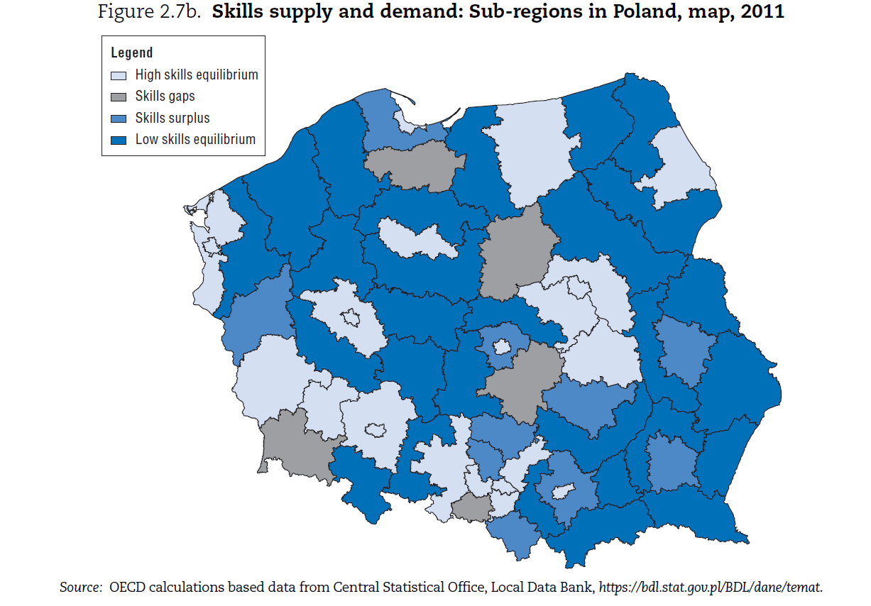

Slide 5
How do countries compare: Employer engagement in the orientation of employment services and training programmes
Note: This indicator is a composite index developed by the OECD based on a qualitative assessment of the extent to which the employment and training system is oriented to employer demand. It is based on the degree of vocational education and training (VET) customisation, whether particular support is provided to SMEs, and the accessibility of workplace training, where 1 corresponds to sub-optimal actions and 5 to a comprehensive set of policies and practices. The same methodology has been applied to all countries represented in the chart above.

Slide 6
Addressing skills shortages and mismatches
Efforts are needed to align the training system with employers and target SMEs
Employers can take a lead role in the design and provision of training opportunities
By stimulating local sectoral networks
Better connecting them to colleges and universities through apprenticeship and work-based training models
Examples: Using industry reps as trainers (United States); Employer Ownership Pilots (UK); Second Career programme (Canada); Skillnets (Ireland)
Notes:
Empowering businesses to grow and to hire workers is at the heart of the philosophy underpinning job creation. Ensuring firms can access the skilled workforce and the financing they need is critically important and there is scope to better incorporate the local and regional dimension into these efforts. An advantage of a bottom-up approach is that institutions can adapt both the mix of provision and curricula to local needs, including local employer demands
Our research has shown that one way of addressing potential skills shortages and mismatch is by ensuring that employers are fully involved in the employment and training system. This means providing employers with a forum to advise on their training needs, while also having them take a lead role in the delivery of training opportunities to develop a skilled workforce. Across the OECD, we are seeing comprehensive efforts to align the skills systems with employer demands including targeted programmes at SMEs, which face particular barriers.
In countries, such as the United States, Australia, and Sweden, industry representatives are used as trainers, which helps to build credibility and ensure that curriculum is aligned with the needs of the labour market. Employers can also take a lead role in facilitating workplace training opportunities.
In the UK, Employer Ownership pilots have been introduced giving employers direct access to government subsidies for workforce training as opposed to the traditional arrangement whereby all government funding goes direct to colleges and training providers. A second round of the pilot programmes is also testing out the development of new Industrial Partnerships - involving employers, unions and others – with a remit for taking wider responsibility for skills development in a place or sector.
Employers can also take a lead role in facilitating workplace training opportunities. While Ireland received a lower comparative score because of its narrow focused apprenticeship system, Skillnets provides a great example on this issue. It is a state-funded, employer-led body that co-invests with employers, particularly SMEs, when they co-operate in networks to identify and deliver training suited to their workforces. A network of SMEs, which are mostly sectoral or regional, is guided by a steering group of the local representatives.

Slide 7
Stimulate demand and strengthening productivity by better utilising skills
Notes:
The first two indicators had more of a supply side focus but a new area for public policy involves stimulating the demand for skills by working with employers to better utilise the skills of their workforce
When employers are reporting skills shortages, these approaches avoid rapidly developing a training course to meet their needs and first focuses on whether there are issues related to the structure and organisation of work within the company

Slide 8
OECD Reviews on Local Job Creation: working with employers on assuring quality jobs and skills utilisation
Note: This indicator is a composite index developed by the OECD based on a qualitative assessment of the extent to which the public sector works with employers to improve skills utilisation and work organisation. The involvement of sector/industry bodies in developing these strategies as well as the degree to which universities and training institutions undertake applied research of relevance to the local economy is also taken into consideration. The same methodology has been applied to all countries represented in the chart above.

Slide 9
In some countries, the government and its partners are…
providing technical assistance and setting an example
working with supply chains and employer networks to stimulate innovation and help employers ‘raise their game’
putting in place management and leadership training programmes
Examples: Wine sector (Niagara Falls); Practice labs for innovative work organisation (Flanders, Belgium)
Notes:
In Flanders, Belgium, collaborations have been built between the unions, academics and government representatives to help managers to promote better skills utilisation in a number of different sectors. Such collaboration is particularly in evidence is the province of Limburg. The fragility of the local economy, which has traditionally been based on low-skilled work and a few major employers, was recently demonstrated by the movement of a major employer, Ford, out of the region. Local policy makers are now faced with the problem of finding new employment for low skilled ex-factory workers whose transferable skills are limited. At the same time, there is a desire to move the region towards more productive higher skilled employment. The local ACV union has responded by setting up practice labs for innovative work organisation, in cooperation with a coalition between academics, unions, enterprises and consultants (Flanders Synergy), subsidised by the Flemish government.
Each lab covers seven themes, each of which is a different area where the manager can have an influence. One theme, for example, has been exploring new ways that firms can expand their market base to improve the quality of their organisation (in terms of efficiency, flexibility, quality, innovation, sustainability) while also improving job quality. Supervisors play the role of coach and act as a sounding board for participants who have questions, both within and outside of the lab sessions. Participants receive assignments to translate theory into practice when they return to the workplace. Unions report that the workshops have improved their relationships with local employers.
In Ontario, Canada, local community colleges and universities appear to be particularly useful partners in helping to raise product market strategies locally. Niagara College, for example, has not only geared their curricula towards meeting local industrial demands in horticulture and wine making (an example being the Winery and Viticulture Technician programme), but has also set up an applied research unit which helps local firms to upgrade their products and business strategies. It collaborates with firms in areas such as product and process applied research, engineering design, technology development, product testing, proof of concept, piloting and problem solving. In 2011, there were 64 applied research projects in progress with more than 50 industry partners.

Slide 10
Dashboard index: Local flexibility/adjustability in the employment policy framework
Note: This indicator is a composite index developed by the OECD based on a qualitative assessment of the extent to which employment policies and programmes are adjustable at the local level. It is based on the degree to which local employment offices have influence over their strategic orientation, programme design, performance and budget management, as well as outsourcing services, where 1 corresponds to sub-optimal actions and 5 to a comprehensive set of policies and practices. The same methodology has been applied to all countries represented in the chart above.
Notes:
I have highlight a number of local employment and economic development initiatives that we have learned about during our series of 12 country reviews. They clearly demonstrate the potential for the local level to take a leadership role in job creation strategies.
One consideration is that the local level can only develop strategies in so far as it is enabled by national policy frameworks.
Based on previous LEED work which has highlighted the importance of flexibility for the employment service in taking a leadership role, we have examined how much flexibility is provided across the 12 countries. When we talk about flexibility, we are not referring to operational flexibility but the ability of the employment services to influence and adjust their:
Strategic approach
Programme design
Eligibility criteria
Budget and performance management; and
Outsourcing arrangements
Here, the results are quite interesting because as you can see, countries which are decentralised politically (outside of Australia) tend to have more flexibility within the public employment service.

Slide 11
Dashboard index: Flexibility tends to improve policy integration and coordination
Notes:
Based on our flexibility measure, we also assessed the degree of policy coordination and integration. By this, we looked at the extent to which the employment service works in partnership with training organisations and economic development agencies.
You can see here that there is a positive relationship between flexibility and policy coordination, which suggests that injecting greater flexibility into the management of policies could bring about reduced silos locally
The one outlier within our study is the Czech Republic and Martin will touch upon why this is the case. At the low flexibility side, Australia is an outlier and this reflects a specific initiative that was introduced by the government to better connect actors locally – a Local Employment Coordinator, who is a government agent designed to facilitate partnerships on the ground.

Slide 12
How are countries injecting local flexibility and integration?
Flexibility in budget management
Negotiating performance management frameworks
Using data to stimulate cooperation and continuous evaluation
Examples: VDAB (Belgium), Workforce Investment Boards (United States), Local Employment Councils (Korea); Workforce Planning Boards (Canada)
Notes:
In terms of injecting greater flexibility and integration locally, we are seeing several interesting approaches being taken.
In Flanders, Belgium, VDAB allows 15% of local budget envelopes to be managed flexibly by local employment offices to design programmes and strategies in partnership with the social partners.
In the United States, there are about 600 Local Workforce Investment Boards, which manage employment and training programmes locally. These board are made up of employers, community college representatives, economic development actors, and other non-profit organisations, leading to some innovative job creation approaches.
Lastly in France, Employment Pacts in the Ile de France region bring together local actors to highlight the difficulties and specific needs of an area and to develop a common strategy. Their signatories , namely the region, the department and the community agree on common goals and actions for a period of three years.

Slide 13
Thank you
Jonathan.barr@oecd.org
Notes:
In conclusion, I hope that this presentation has highlighted some interesting practices across the participating countries, which can serve as a basis for mutual learning.
I have had the fortunate opportunity travel to all 12 countries participating in the project. One factor which is common across all the countries and for which international comparison cannot be made is the amount of passion, knowledge and expertise at the local, regional and national level.
Thanks!

